Slide 1
Final Presentation
I.L.A.T.S.
(Infrared Light Asset Tracking System)
By:
Moheb Amini (mamin004@ucr.edu)
Mark Logston (mlogs001@ucr.edu)
Ahmed El Gabaly (aelga001@ucr.edu)

Slide 2
Concept and Application of Design
A Real-Time Locating system (RTLS)
Transmitters that send signals to receivers which determine object location
Uses Optical communication to transmit data
Related to Electronics, Optoelectronics, Signal Processing, Telecommunication and Embedded systems
This design is intended to be implemented in an industrial setting: mainly hospitals

Slide 3
Technical Design Objective
Succeed to efficiently identify the location of the 2 different transmitters, each with it’s own unique signature, within 2 rooms and 1 hallway (3 receivers)
To Achieve this we need:
Object motion in xyz values using accelerometer
Transmit a signal of at least 8ft to receiver
FFT of received signal to identify each signature
Server response time of at least 400ms
Have Low Power Consumption

Slide 4
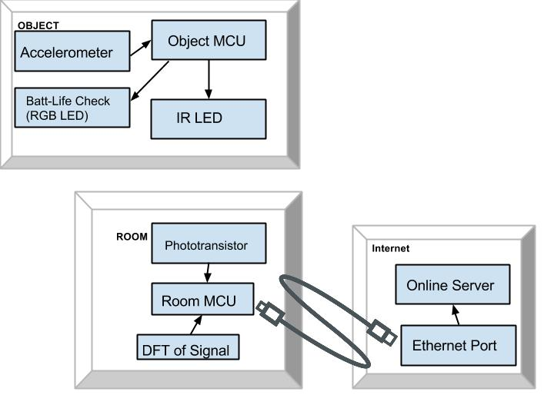
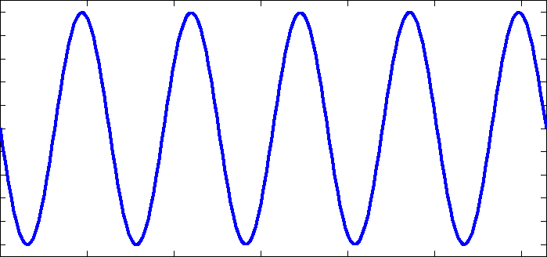
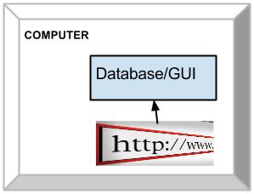
Final High Level Block Diagram Design
(For each room and object)
Changes from previous High Level Design:
- Incorporated a battery life checker on the objects
- Changed the type of IR Sensor in the room block
- Created another block in the diagram for online server
- Automatically access server through GUI
- Added FFT analysis to the room block

Slide 5
Technical Challenges
Getting accurate data analysis using FFT
Amplification of the Photodiode signal
Change photodiode to phototransistor
Disregard TIA amplifier
Sending FFT data to an online server gathering and relaying data to GUI
Hardware Issues
Sensor alignment
Issue with MCU
Sensor ADC value accuracy

Slide 6
Major Tasks
Moheb Amini:
Communication from the Infrared LED and the Phototransistor
I2C communication from Accelerometer to a microcontroller
Creation of Circuits
Create FFT to analyze incoming signals
Transmitter PCB Design
3D printed Receiver Mount Design
Ahmed El Gabaly:
Set up the microcontroller of the photodiode to send the incoming data to Ethernet
Communication from the Photodiode microcontroller to the Server
Creation of Battery Life Checker
Receiver PCB Design
Mark Logston:
Creating the GUI
Creating the Database
Creation of Circuits
Alignment of Infrared Transistors
Helped in creation of Transmitter and Receiver PCBs

Slide 7
Design considerations
Realistic constraints
Power consumption of the Transmitter
Cost of transmitter and Receiver
Receiver mounting location
Arduino Ram size
Phototransistor vs. PhotoDiode
Frequency choice
Industry Standards
I2C
TCP/IP
IEEE 802.3 (Ethernet)
Changes:
Mounting Location
Using Phototransistor

Slide 8
Test Report
To test the system as a whole we at first tested each part separately
FFT of transmitted Signal to identify each transmitter
Send data to online server and read data from server
Distance from transmitter to receiver
Able to get 8 ½ feet
Server Response time
Able to respond fast enough for normal walking speed
GUI
Power consumption: 0.506 𝜇W
Mounted Receivers above door and moved transmitters underneath seeing if the correct room/hallway number appeared on GUI in response to transmitter

Slide 9
Demo
Video Demo:
http://youtu.be/8rx8W-GGqlw&hd=1

Slide 10
Summary
Able to track two objects moving between two rooms and a hallway
Infrared sensor reading Infrared waves at different frequencies
FFT converting given input with multiple signals and noise
Room Microcontroller send current object location via Ethernet
Display Correct Room and Hallway Numbers on GUI by accessing the server

